Slide 1
Block Pricing
Module 6 · Video 8
Management 405
Prof. Nico Voigtländer · UCLA Anderson

Slide 2
Module 6 · Video 8 · Agenda
Outline of Module 6
1
Simple vs. Complex Pricing
Video 2
2
Direct Price Discrimination
Videos 3+4
2a
Perfect Price Discrimination (First Degree)
Video 3
2b
Segment Pricing (Third Degree)
Video 4
3
Indirect Price Discrimination (Second Degree)
Video 5
4
Advanced Pricing Strategies
Videos 6–8
4a
Flat Fee Pricing
Video 6
4b
Two-Part Tariff
Video 7
4c
Block Pricing
A lower price as the same customer buys more
Video 8
5
Summary of Pricing Strategies
Video 9
Management 405 · Module 6 · Complex Pricing and Advanced Pricing Strategies
2
Notes:
The last of the three: charging less as the same customer buys more.

Slide 3
Module 6 · Video 8 · Block Pricing
Block Pricing
Block pricing is the practice of reducing the price of a good
when the same customer buys more of it
The discount is tied to the QUANTITY one customer takes,
not to who the customer is
Management 405 · Module 6 · Complex Pricing and Advanced Pricing Strategies
3
Notes:
Block pricing reduces the price when the same customer buys more of the good. Notice what makes it different from the segment pricing we did earlier: the discount is tied to the quantity one person takes, not to who that person is. The firm does not need to know anything about the customer.

Slide 4
Module 6 · Video 8 · Block Pricing
Block Pricing: Photo Cards at Walmart
P ($/card)
Three purchase options:
100 cards at $25
125 cards at $30
175 cards at $35
Marginal cost of printing photo cards: MC = $0.05
Assume zero fixed costs
The first option is 100 cards at $0.25 each
  Profits are A (since TFC = 0)
Sell additional 25 cards at $0.20 ($5 extra for 25 cards)
  Additional profits B
Sell yet additional 50 cards at $0.10 ($5 extra for 50 cards)
  Additional profits C
$0.25
$0.20
A
D
B
$0.10
C
$0.05
MC
100
125
175
Q (photo cards)
Management 405 · Module 6 · Complex Pricing and Advanced Pricing Strategies
4
Notes:
Note that the pricing strategy can also be expressed as 100 cards at $25, 125 at $30, and 175 at $35. Consumers will opt to purchase 175 at $35, and Walmart still increases its producer surplus.

Slide 5
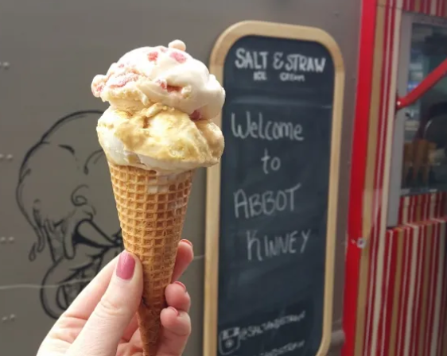
Module 6 · In Class · Examples · Block Pricing
Block Pricing: Ice Cream
P ($/scoop)
Marginal cost = $1 per scoop
Purchase options:
1 scoop for $4
2 scoops for $7
3 scoops for $8.50
$4.00
$3.00
A
B
$1.50
C
D
MC
$1.00
1
2
3
Q (scoops per customer)
Management 405 · Module 6 · Complex Pricing and Advanced Pricing Strategies
5
Notes:
One scoop is four dollars, two are seven, three are eight fifty. So the second scoop costs three dollars and the third one fifty. Each block sits under the same demand curve, and the customer walks herself down it, handing over most of the surplus on the way.

